Slide 1
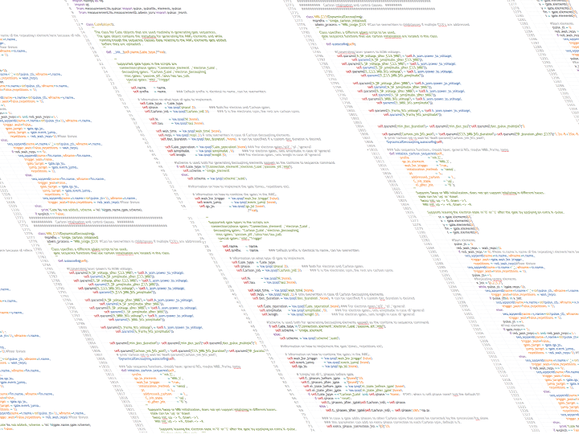


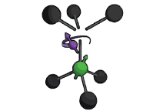

Parity Measurements on Weakly Coupled Carbon Spins in Diamond

Slide 2
Action title relating to next chapter
Introduction to Quantum Information
Quantum Error Correction and the Parity Measurement
The Nitrogen Vacancy Center in Diamond
Controlling Weakly Coupled Carbon Spins
The Parity Measurement
Towards Quantum Error Correction
Here some visual about the next section

Slide 3

Parity Measurements on Weakly Coupled Carbon Spins in Diamond
Master’s Thesis Presentation Michiel Adriaan Rol
Supervisors :
Ir. J.Cramer
Dr. Ir. T.H. Taminiau
Prof. Dr. Ir. R. Hanson
Performed at:
Quantum Transport group
Kavli Institute of Nanoscience
Delft University of Technology

Slide 4


Parity Measurements on Weakly Coupled Carbon Spins in Diamond
Master Thesis Presentation Adriaan Rol
Why do we do this and what is a quantum computer
The NV-center in Diamond
Extending electron coherence
Controlling weakly coupled carbons
Towards quantum error correction

Slide 5


A Quantum Computer promises an exponential speedup over conventional computers
adf
Figure from The Economist: Quantum Computing feb 25th 2012

Slide 6
A qubit is the quantum analogue of the classical bit
Classical Bits vs Quantum Bits
Bit
Qubit
0
1
What’s different?
Wavefunction Collapse (Can only measure along one axis) ->
Entanglement (multi-qubit)
Essential, Explain rotation
Explain Rotation of qubits

Slide 7
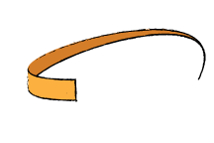
A Qubit differs from a classical bit on three important characteristics
Direction of the arrow contains information and precesses
A measurement projects
Multiple Qubits can Entangle
Decoherence not in here yet

Slide 8
When you measure a qubit it gets projected

Slide 9
Entanglement is when two particles are independent of each other
If you measure 1 you get arbitrary result
If measure both will measure correlations

Slide 10
Quantum Error Correction is essential in building a scalable quantum computer
What happens if we make an error ?
Errors are a Problem
Classical -> Errors Average out
Quantum -> Errors add up
Classicaly we correct it
Can we do that quantum?
Because errors add up need to correct
Classical Error correction -> Majority voting
Classical Error Correction does not work
-No Cloning -> Prevents destroying clones
- Wave function collapse

Slide 11
By measuring the parity an Error can be diagnosed and corrected
Encode
Diagnose
Correct
NOTE: No entanglement explained yet, do I need it ?

Slide 12
The NV-center is a promising candidate for quantum computation
Node based architecture
Combination of optical and solid state qubits

Slide 13

The NV-center is an impurity in Diamond which we can control
afs
Optical Readout
MW spin control
Dont’ explain strongly coupled control unless necessary
Notes:
Slide Showing optical Readout
Arrow up -> photon out
Arrow down-> no response
MW control, can turn purple spin around. (rotate the spin).

Slide 14
We can use the optical interface to link multiple NV-centers together
Optical Interface allows linking of nodes
Well protected local qubits in solid state environment

Slide 15
Parity Measurements on Weakly Coupled Carbon Spins in Diamond
Master Thesis Presentation Adriaan Rol
Notes:
Red circle:
Coupling strength determines how fast we can address.
Closer is stronger coupling. Must be faster than decoherence of the electronic spin.
Red line is boundary set by T2*
Within Strongly coupled
Outside Weakly coupled
Few within coherence
Animation 1 laser pulse: -> Dephasing of close by spins.
Few strongly coupled
Conclusion, we need to extend coherence to be able to address stronger coupled.
We Address Weakly Coupled Carbons in order to find enough suitable qubits

Slide 16
We can measure how long we have to addres carbons with a ramsey experiment
Ramsey Experiment

Slide 17
Coherence can be extended by applying additional pi pulses
Spin-Echo
Compare to Ramsey -> Add reference to Gijs for DD

Slide 18
Coherence can be extended further by applying more pi pulses
Dynamical Decoupling
x 240 !
Source: De Lange et al. Science (2010) DOI: 10.1126/science.1192739
Notes:
TDD > 40 ms was measured at N = 256 pulses, no end in sight yet.

Slide 19
Parity Measurements on Weakly Coupled Carbon Spins in Diamond
Master Thesis Presentation Adriaan Rol
Notes:
Animatie: Dynamical decoupling
1 –pulse -> stuk groter
meerdere keren heen en weer bewegen -> Cirkel wordt stuk groter

Slide 20
Carbons rotate around different axes depending on the electron state
Notes:
Hyperfine interaction present for ms = +1, not present for ms=0

Slide 21


By rapidly changing the rotation axis of a carbon we can selectively control it
Needs selective
Animation of NV going up and down

Slide 22
Using dynamical decoupling we are able to initialize and readout a carbon spin
Might be too detailed for this presentation. Is it needed?

Slide 23
Parity Measurements on Weakly Coupled Carbon Spins in Diamond
Master Thesis Presentation Adriaan Rol
Notes:
Animatie: Dynamical decoupling
1 –pulse -> stuk groter
meerdere keren heen en weer bewegen -> Cirkel wordt stuk groter

Slide 24
Parity Measurements on Weakly Coupled Carbon Spins in Diamond
Master Thesis Presentation Adriaan Rol
Notes:
Animatie: Dynamical decoupling
1 –pulse -> stuk groter
meerdere keren heen en weer bewegen -> Cirkel wordt stuk groter

Slide 25
weakly cc C can be controlled by DD

Slide 26
We Perform a Parity Measurement by Mapping the State of the Carbon on the electron
Requires entanglement

Slide 27
In Order to Implement Quantum Error Correction we need to be correct the outcome of a parity measurement

